Slide 1
Economic Resiliency in Summit County
Stephanie Copeland
Executive Director OEDIT
Elizabeth Garner
State Demographer DOLA

Slide 2

Big Picture: 2016-17 Population Change
U.S. Population 2017: 325.7 Million +2.3 Million (0.7%)
Colorado 2017 (Census): 5,607,154
9th fastest growth: 1.4% - ID, NV, UT, WA, FL
8th total growth: 77,049 - TX, FL, CA, WA, NC, GA, AZ
Colorado: 1.5% avg annual growth
Summit County: 1.6%

Slide 3
Transitions to Watch
Disparity – growth, income, jobs, education.
Migration – attracting and retaining the right fit.
Aging – labor force, income, housing, jobs
Changes to industries – booms, downturns, automation, retail, manufacturing, construction.
Increasing racial and ethnic diversity.
Slowing income growth
Population growth (but slowing) – planning for the people (and everything that comes with them)

Slide 4
Summit County
Unemployment rate: 1.9%
Average wage: $733/week

Slide 5
Unemployment Rate
Area | Labor Force | Employed | Unemployed | Unemp. Rate
Colorado | 2,992,307 | 2,907,468 | 84,839 | 2.8%
Eagle County | 35,052 | 34,240 | 812 | 2.3%
Pitkin County | 11,032 | 10,691 | 341 | 3.1%
Summit County | 22,008 | 21,598 | 410 | 1.9%
5

Slide 6
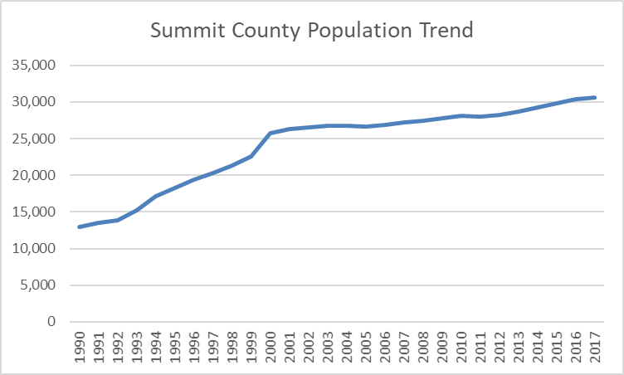
Population Growth
6

Slide 8
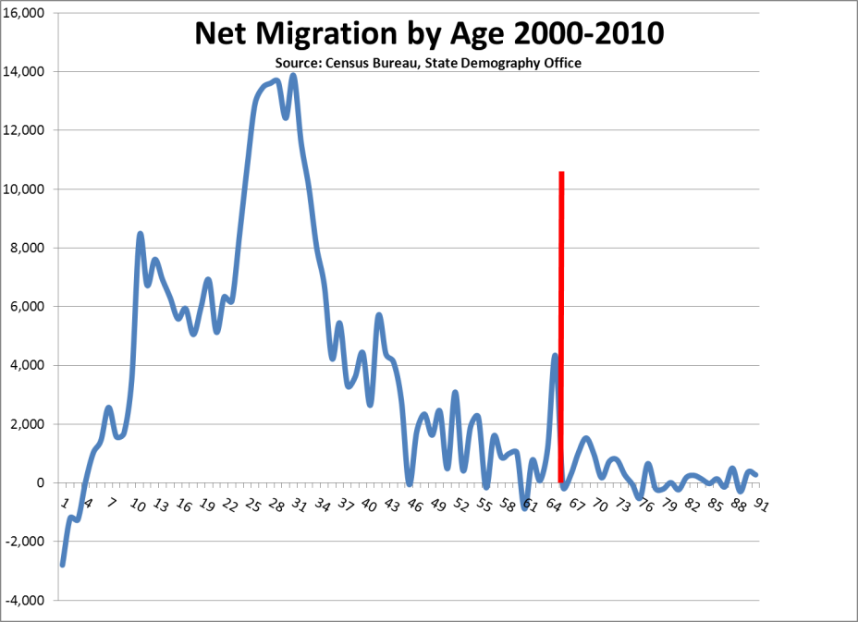
Colorado Migration by Age
Notes:
Negative impact: driving talent out

Slide 9
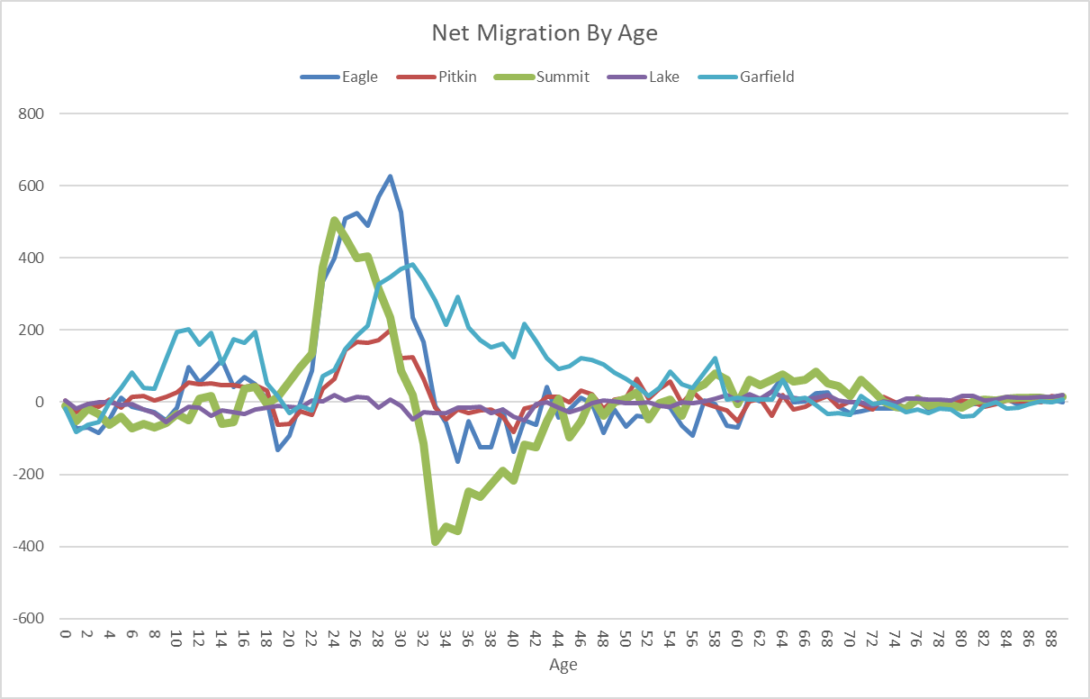
Regional Migration by Age
Notes:
Negative impact: driving talent out

Slide 10
JOBS ARE PEOPLE
Notes:
Negative impact: driving talent out

Slide 11
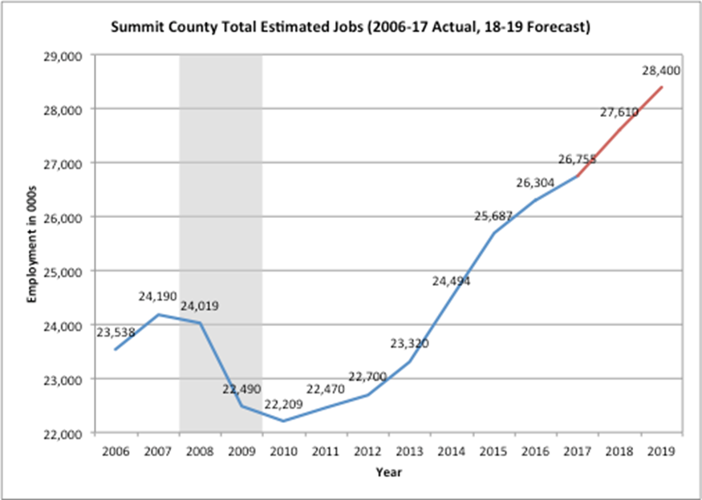
Summit Jobs Trend

Slide 12
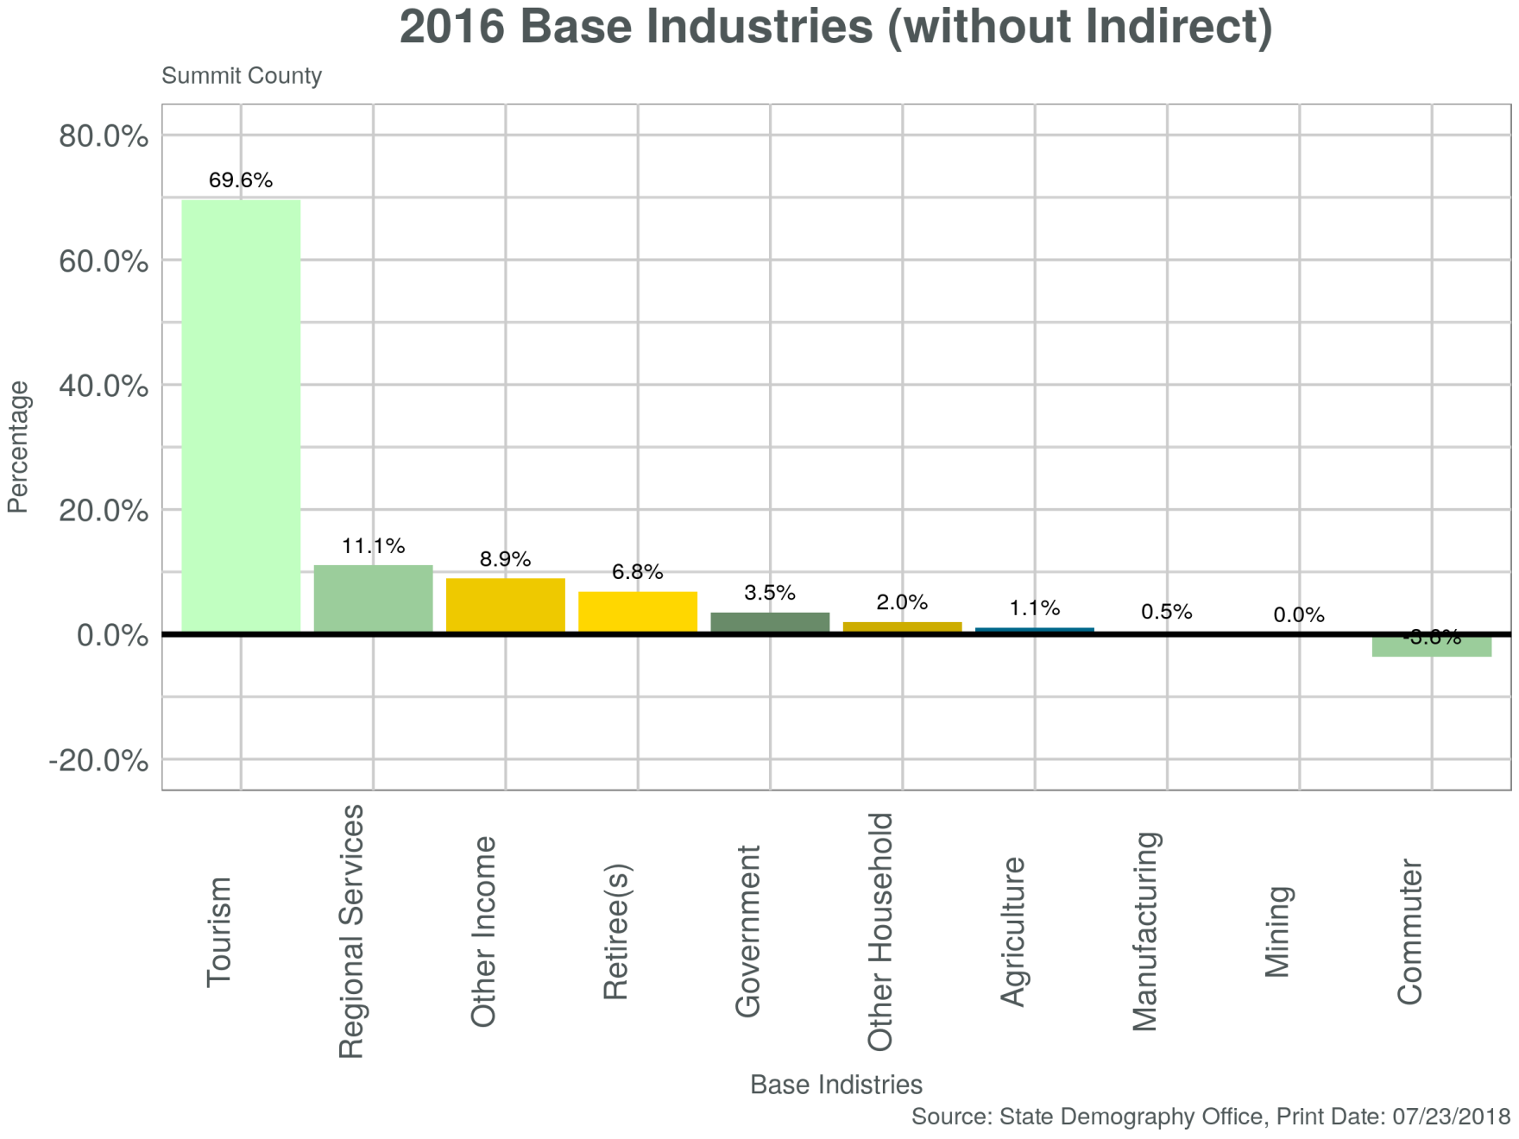
Summit County Base Industries
Notes:
All of the base industries are defined in this document from our website. Tourism includes includes Resorts, second homes, transportation and service​​

Slide 13
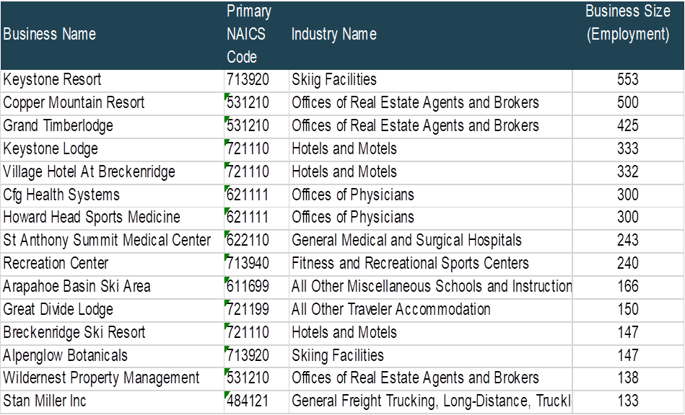
15 Largest Employers

Slide 15
Notes:
Only one of top growing industries is high wage (Health services) and construction hasn’t rebounded to pre-recession levels.

Slide 16
Employment by County
Total Employment Pre-Recession to 2017
 | Total Change 2008-17 | Pct.(%) Change 2008-17
Statewide | 381,314 | 13.0%
Eagle | 743 | 1.8%
Garfield | -2,721 | -7.4%
Lake | 251 | 8.8%
Pitkin | -976 | -4.4%
Summit | 2,566 | 10.6%

Slide 17
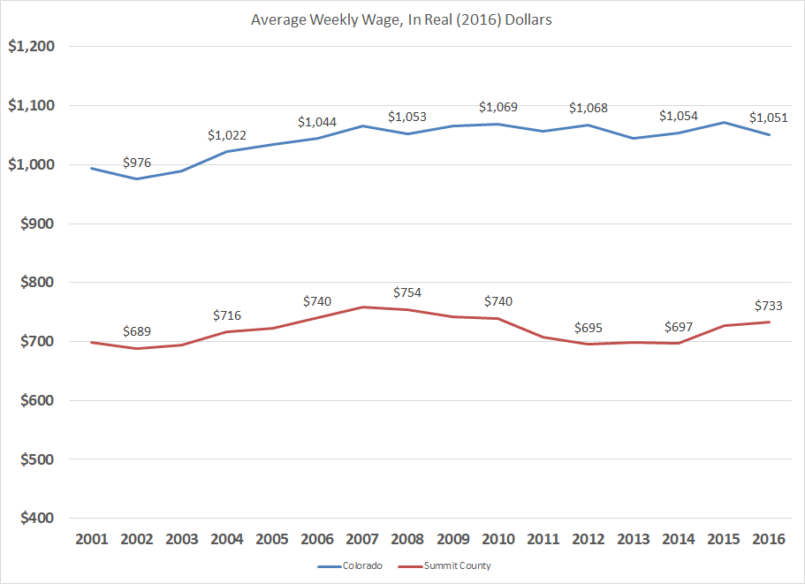
Summit County Weekly Wage Trend

Slide 18
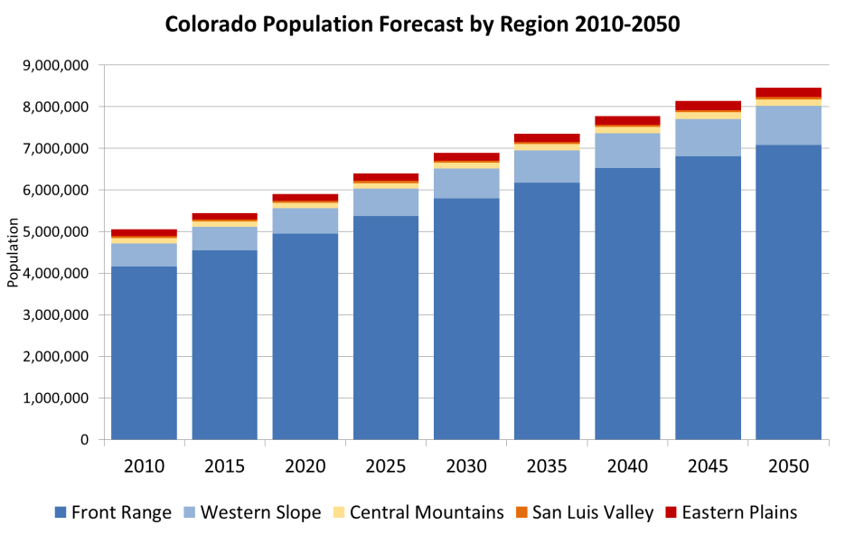
Colorado Population Forecast

Slide 19
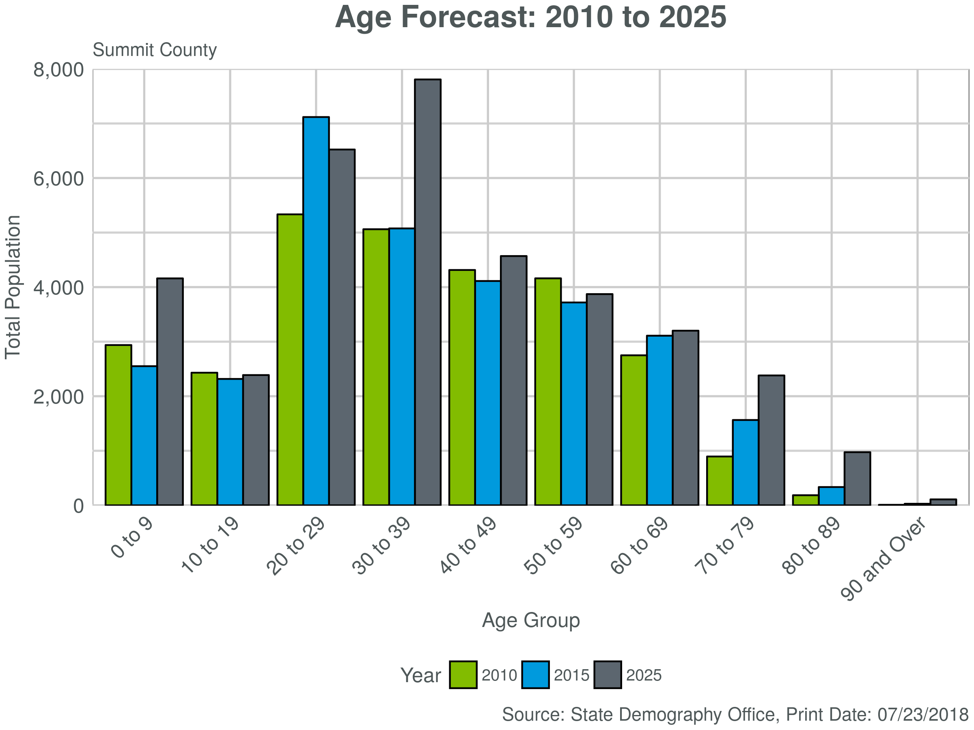
Summit County Age Forecast

Slide 20
Summit County Population Forecast
Population Forecast Region 12 & Garfield
 | July, 2015 | July, 2020 | July, 2030 | July, 2040 | July, 2050 | Total Ch. 2015-50 | Ann. Ave. Pct Growth 2015-50
Region 12 + Garfield | 174,827 | 190,676 | 227,713 | 267,455 | 303,891 | 129,064 | 1.6%
Eagle | 53,320 | 57,571 | 69,748 | 83,001 | 94,459 | 41,139 | 1.6%
Grand | 14,602 | 16,330 | 19,487 | 23,606 | 27,406 | 12,804 | 1.8%
Jackson | 1,353 | 1,333 | 1,316 | 1,300 | 1,279 | -74 | -0.2%
Pitkin | 17,845 | 18,562 | 20,218 | 21,854 | 23,209 | 5,364 | 0.8%
Summit | 29,928 | 32,760 | 39,540 | 45,859 | 51,828 | 21,900 | 1.6%
Garfield | 57,779 | 64,119 | 77,404 | 91,836 | 105,711 | 47,932 | 1.7%

Slide 21
Strengths
Attracting high volume of young talent (post college age)
Jobs are 10% above pre-recession peak levels
Strong amenities and quality of life
Notes:
Have most ingredients necessary for success with exception of industry diversity and the ability to retain talent

Slide 22
Weaknesses
Retention of talent (30s)
High volume of low wage jobs creating significant lag to state average
Lack of industry diversity
High cost of housing

Slide 23
Threats
Macro economic trends
External factors
Housing availability to retain workforce
Racial disparity of educational attainment
Core high wage jobs are susceptible to downturn
Notes:
We are 10 years into a conventional 10 year economic cycle

Slide 24
Summary
Population segment vulnerabilities
High industry concentration
Jobs 10% higher than pre-recession peak levels
Wage drag from amount of low and average paying jobs
Low unemployment rate not providing wage lift
Notes:
Economic resiliency relies on healthy industry diversification, population composition and wage growth
Achieving resiliency requires deliberate planning

Slide 25
So What’s the Answer?
Notes:
Economic Resiliency concept: Some communities bounce back quickly from downturns, but others lag behind and sometimes never completely recover. Economic resiliency can be thought of as the ability of an economy to recover from or adjust to the effects of adverse shocks.

Slide 26
Economic Resiliency:
Some communities bounce back quickly from downturns, but others lag behind and sometimes never completely recover.
Economic resiliency conceptualized: the ability of an economy to recover from or adjust to the effects of adverse shocks.
Notes:
Economic Resiliency concept: Some communities bounce back quickly from downturns, but others lag behind and sometimes never completely recover. Economic resiliency can be thought of as the ability of an economy to recover from or adjust to the effects of adverse shocks.

Slide 27
What it Looks Like:
Growing population built on opportunity
Industry diversification that hedges economic cycles
Wage dispersion to bolster local revenues

Slide 28
Why it Matters:
Provides vital context for your data
Reveals actionable trends
Resilient communities are less vulnerable to economic/industry cycles and external forces
Resilient communities control their destiny

Slide 29





Project Overview
With support from:

Slide 30

Project Overview
Goal:
To understand why some communities in Colorado thrive while others fail to retain population and sustain economic growth
Process:
Studied identifiable factors that differentiate a path of success for communities
Analyzed multiple sources of secondary data
Conducted primary research focus groups and interviews in select counties

Slide 31
Findings: Why do you want to be a resilient community?
Vibrancy
Versatility
Durability
Risk Mitigation

Slide 32
Case Study: Drivers of Resiliency
Diversity of Industry
Broad Wage Dispersion
Growing Population
Age Dispersion
Rich Infrastructure
Notes:
Communities identify industry diversity, broad wage dispersion, growing population, age dispersion and rich infrastructure as the primary drivers of economic resiliency.
Drivers of Resiliency: Focus group data and interviews with communities members show the following as drivers for resiliency in their community.
Industry Diversity: Community members defined this component as a diverse set of industries within a community is key to making it resilient. Being heavily dependent on a single industry creates economic uncertainty within a community, especially during times of economic downturn.
Salida Success Story in Resiliency.
When faced with the dissolution of the town’s primary industry, mining, in the 1980’s, instead of succumbing to the subsequent economic downturn, the business leaders instead decided to focus is efforts on revitalizing its historic downtown district.
Business leaders charged themselves with the task renovate the historic Steam Plant into a multipurpose community theater and event center
They eventually sold the Steam Plant to the city for $1

Slide 33

Case Study: Challenges to Resiliency
Lack of labor supply
Single industry reliance
Non-coordinated infrastructure
Lack of opportunity

Slide 34
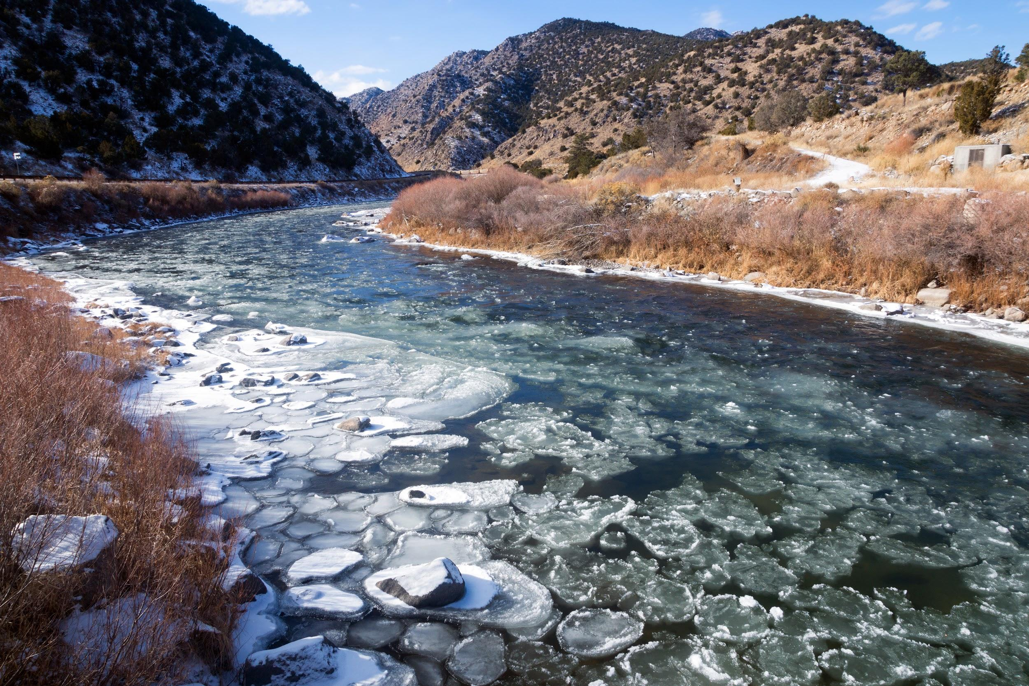

Vision for your community
Steps to Resiliency
Create a development plan with buy-in and input from the community
Be authentic and realistic about infrastructure goals
Think and act regionally
Notes:
Vision your community
Through community engagement and visioning sessions, Durango, for instance, has created and implemented development plans with the support of the community. Every community develops differently; however, it is important that each community has a vision and grows in the most authentic way.
• Input and buy-in: For a development plan to succeed, it must be built on collective input that cultivates community buy-in. Identify where you want to play, Decide what kind of community you want to be.
• What’s realistic for you? Being authentic and realistic about infrastructure goals is essential for success. Determine missing elements to succeed (e.g. airport, education, infrastructure, health services) and which are viable for you.
• Greater than the sum: Together you can achieve more. Think and act regionally.
Create a development plan with buy-in and input from the community.
Think creatively and be authentic to your community’s personality when creating a vision for your community.

Slide 35
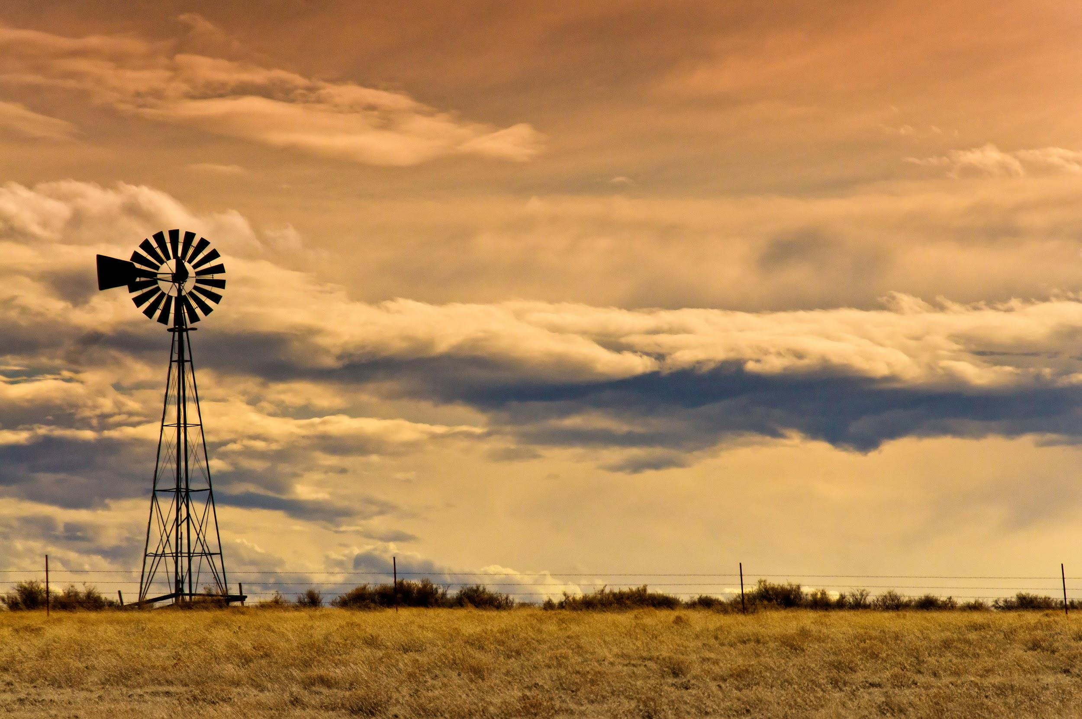
2. Placemaking/Brand
3. Seize opportunities and take risks
Steps to Resiliency
Develop and foster a culture of commitment, seizing opportunities, and diversifying your community’s industries
Take risks and invest
Identify community assets ideal for community placemaking
Notes:
2. Placemaking/Brand:
Durango and Salida recognized that their natural amenities and historic downtown districts are their greatest assets. Over the past 30 years both communities have focused resources and energy to building, improving, and maintaining these assets.
Throughout the state, regardless if communities are located in the eastern plains or western slope, the natural amenities and historic districts attract people to the region building vibrancy in the community. With a diverse set of amenities across the state (e.g. rivers, hills, mountains, and agricultural lands), Colorado communities have an opportunity to identify and invest in their assets to create place where people want to live, work, and recreate.
3. Seize opportunities and take risks
Example: during an economic downturn with the closure of the Climax mine in the 1980’s, leaders in the Salida business community recognized the need for revitalization and stabilization of the local economy. Identifying the old Steam Plant as a potential asset, the businesses acquired the and renovated the building. The risky investment required creativity and a long-term vision for the community. Today, the Steam Plant is the heart and soul of the community.

Slide 36
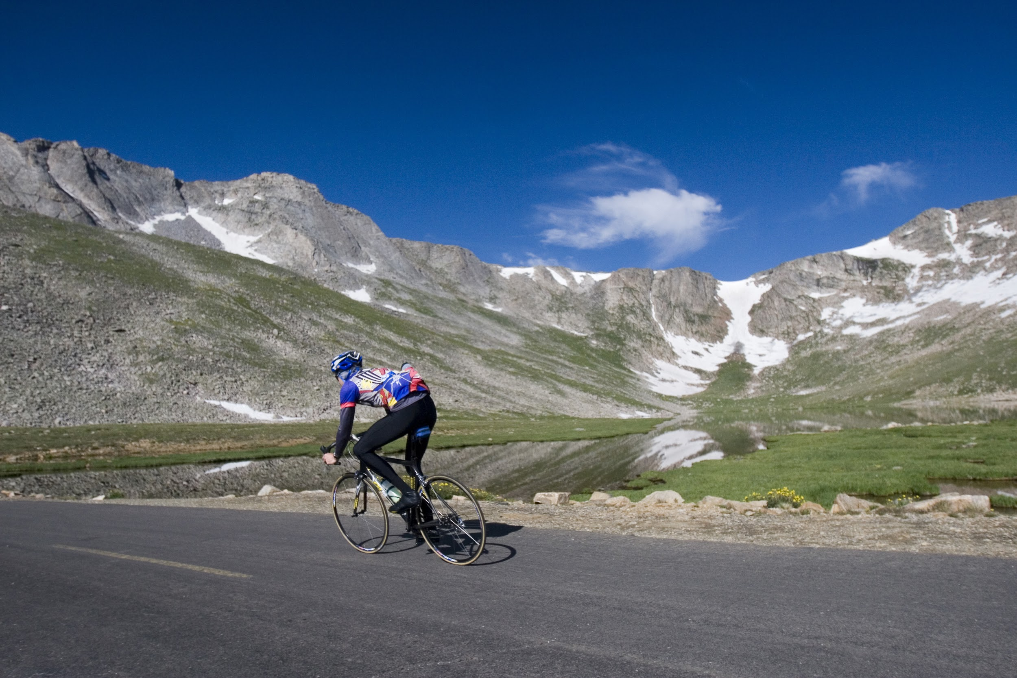
4. Invest in education and healthcare
5. Infill/density and annexation options
6. Enable new business in your region
Steps to Resiliency
A tool for family and labor retention
Inventory annexation options, evaluate policies
Allow local talent to facilitate business organically
Notes:
4. Invest in education and healthcare
A key tool for family and talent retention is education and healthcare. Do you have the education to attract the talent seeks for family development? Do you have healthcare solutions as they progress through the lifecycle?
5. Infill/density & annexation options
A tight housing market presents a challenge for many communities throughout the state. Currently, both Durango and Salida are evaluating how to create greater density in the downtown areas
Inventory infill and annexation options and evaluate infill and annexation policies.
6. Enable new business in your region
Allow local talent to facilitate business organically.

Slide 37

7. Empower and Engender Leaders
Steps to Resiliency
Champion current leaders, making them ambassadors for your community
Develop young professional leadership programs
Notes:
7. Empower and engender leaders
Leadership is different in every community as it may come in the form of grassroots efforts, private sector and board engagement, or from elected officials.
Leaders in both Durango and Salida play a major role in gaining public buy-in for development projects, fundraising, and pushing a project to completion.
It is important to identify and champion leaders and provide resources and support for emerging leaders and youth in the community.

Slide 38
Achieving Economic Resiliency Requires
A collaborative plan
A regional mindset and approach
Strong leadership
Notes:
You cant be a victim of resiliency. Must be deliberate.

